Slide 1
Database Systems
Lecture 1
Database System Concepts and Architecture
Chapter 2
Alina Arshad
alina.arshad@nu.edu.pk

Slide 2
Data Models
Data Model:
A set of concepts to describe the structure of a database, the operations for manipulating these structures, and certain constraints that the database should obey.
Data Model Structure and Constraints:
Constructs are used to define the database structure
Constructs typically include elements (and their data types) as well as groups of elements (e.g. entity, record, table), and relationships among such groups.
Constraints specify some restrictions on valid data; these constraints must be always enforced.

Slide 3
Data Models (continued)
Data Model Operations:
These operations are used for specifying database retrievals and updates by referring to the constructs of the data model.
Operations on the data model may include basic model operations (e.g. generic insert, delete, update) and user-defined operations (e.g. compute_student_gpa, update_inventory)

Slide 4
Categories of Data Models
1) Conceptual Data Model (High-level): Provide concepts that are close to the way many users perceive data. (Also called entity-based or object-based data models.) it have three main concepts: entities, attributes, and relationships.
Entity: real-world object or concept i.e. employee or a project.
Attribute: describes an entity i.e. employee’s name or salary.
Relationship: association among the entities, for example, a works-on relationship between an employee and a project.
2) Implementation or (Representational) data models: represent data by using record structures and hence are sometimes called record-based data models.
Notes:
Example: The Entity-Relationship (ER) model is a popular conceptual data model that uses entities, attributes, and relationships to describe the data.

Slide 5
Categories of Data Models
3) Physical data models: describe how data is stored as files in the computer by representing information such as record formats, record orderings, and access paths.
Access path: search structure that makes the search for particular database records efficient, such as indexing or hashing.
4) Self-Describing Data Models:
Combine the description of data with the data values. Examples include XML, key-value stores and some NOSQL systems.

Slide 6
Schemas versus Instances
Database Schema: The description of a database is called the database schema, which is specified during database design and is not expected to change frequently.
Includes descriptions of the database structure and the constraints that should hold on the database.
Schema Diagram: An illustrative display of (most aspects of) a database schema.
Schema Construct: A component of the schema or an object within the schema, e.g., STUDENT, COURSE.

Slide 7
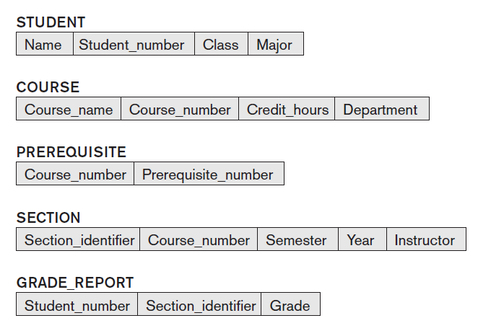
Schema diagram for the database
Schema Construct: Each object in the schema i.e. STUDENT or COURSE

Slide 8
Schemas versus Instances
Database State:
The actual data stored in a database at a particular moment in time. This includes the collection of all the data in the database.
Also called database instance (or occurrence or snapshot).
The term instance is also applied to individual database components, e.g. record instance, table instance, entity instance

Slide 9
Database Schema vs. Database State
Initial Database State:
Refers to the database state when it is initially loaded into the system.
Valid State:
A state that satisfies the structure and constraints of the database.
Distinction:
The database schema changes very infrequently. The database state changes every time the database is updated, or any insertion or deletion is made.
Schema is also called intension, whereas state is called extension.

Slide 10

Example of a database state

Slide 11
The Three-Schema Architecture/ ANSI/SPARC
The goal of the three-schema architecture is to separate the user applications from the physical database.
Proposed to support and visualize DBMS characteristics of:
Use of a catalog to store the database description (schema) so as to make it self-describing
Program-data independence.
Support of multiple views of the data.
Notes:
ANSI/SPARC (American National Standards Institute/ Standards Planning And Requirements Committee architecture,

Slide 12
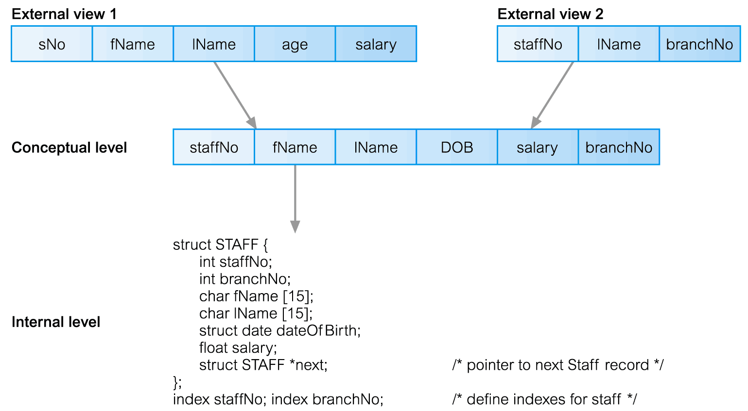
Differences between Three Levels of ANSI-SPARC Architecture

Slide 13
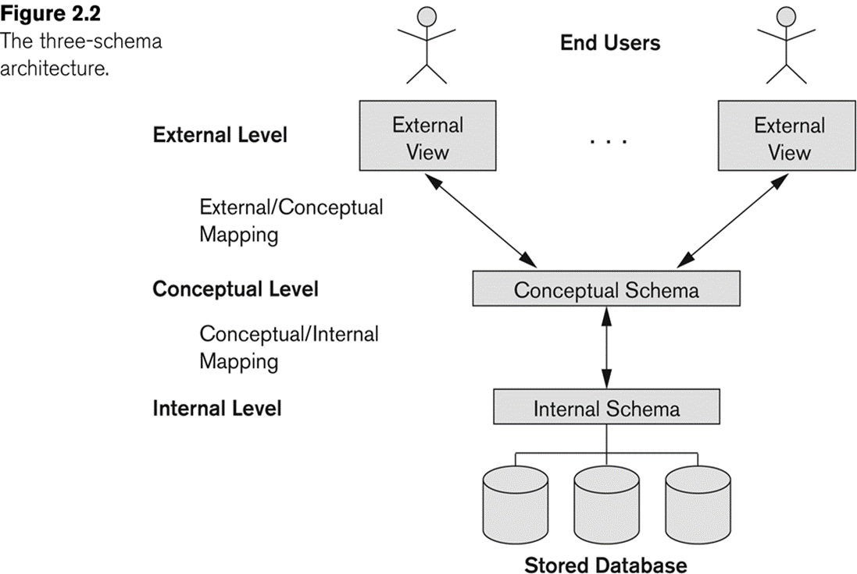
The Three-Schema Architecture/ ANSI/SPARC
Notes:
Mappings among schema levels are needed to transform requests and data.
Programs refer to an external schema, and are mapped by the DBMS to the internal schema for execution.
Data extracted from the internal DBMS level is reformatted to match the user’s external view (e.g. formatting the results of an SQL query for display in a Web page)

Slide 14
Three-Schema Architecture/ANSI/SPARC
Defines DBMS schemas at three levels:
Internal schema at the internal level to describe physical storage structures and access paths (e.g indexes).
Typically uses a physical data model.
Conceptual schema at the conceptual level to describe the structure and constraints for the whole database for a community of users.
Uses a conceptual or an implementation data model.
External schemas at the external level to describe the various user views.
Usually uses the same data model as the conceptual schema.

Slide 15
Three-Schema Architecture/ ANSI/SPARC
Mappings among schema levels are needed to transform requests and data.
Programs refer to an external schema and are mapped by the DBMS to the internal schema for execution.
Data extracted from the internal DBMS level is reformatted to match the user’s external view (e.g. formatting the results of an SQL query for display in a Web page)

Slide 16
Data Independence
Logical Data Independence:
The capacity to change the conceptual schema without having to change the external schemas and their associated application programs.
Physical Data Independence:
The capacity to change the internal schema without having to change the conceptual schema.
For example, the internal schema may be changed when certain file structures are reorganized, or new indexes are created to improve database performance
If the same data as before remains in the database, we should not have to change the conceptual schema.

Slide 17
Data Independence (continued)
When a schema at a lower level is changed, only the mappings between this schema and higher-level schemas need to be changed in a DBMS that fully supports data independence.
The higher-level schemas themselves are unchanged.
Hence, the application programs need not be changed since they refer to the external schemas.

Slide 18
Any question????

